Slide 1
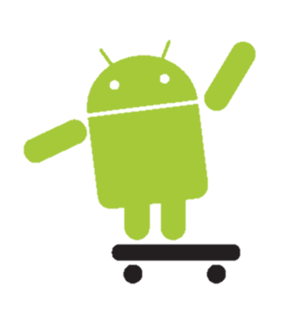
Making a Simple App
RedbirdHacks 2015

Slide 2

Overview
Learn some history on Android
Learn basic Android concepts by building an app that allows the user to build an display a grocery list
Activities
Intents
List and Adapters

Slide 3
Get the Project from GitHub
Go to this link: https://bit.ly/HackISU
Download the ZIP of the project
Extract the ZIP file and save it to your computer
In Android Studio, File > Open, then navigate to where you unzipped the file

Slide 4
History
Android is an open-source mobile operating system
Bought by Google in 2005
First released in T-Mobile G1
Began picking up speed in 2008 with Eclair release and Motorola Droid
First Google flagship phone released in same year: Nexus One

Slide 5
Versions
Honeycomb (2011) – increased support for tablets, refined UI
Ice Cream Sandwich (2011) – UI updated to the max
Jellybean (2012) – more UI updates, Roboto font, Google Now
KitKat (2013) – design updates, increased perfomance
Lollipop (2014) – beautiful UI redesign, design specs, WEARABLES!

Slide 6
Project Structure
Select “Project” view in upper right corner
XML files
The layouts for your screen
Located in [App Name] > app > src > main > res > layout
Java files
“Meat” of your apps
Located in [App Name] > app > src > main > java > [Package Name]

Slide 7
UI Elements
The UI is the user-facing portion of the code that interacts with the user
We put Views in XML layouts to render the UI
ImageView
TextView
EditText
Button
ListView

Slide 8
EditTexts
Displays field in which user can enter text when rendered.
You must assign its attributes to give it a desired look
id: ID of the View (stored as an int)
layout_width: width of the View
layout_height: height of the View
hint: text that displays by default in the field
inputType: determines which type of keyboard shows up

Slide 9
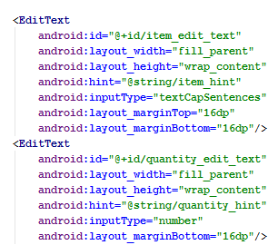
EditText Example (activity_main.xml)

Slide 10
Buttons
Displays a button when rendered
Attributes:
id: ID of the View (stored as an int)
layout_width: width of the View
layout_height: height of the View
text: text displayed on button

Slide 11
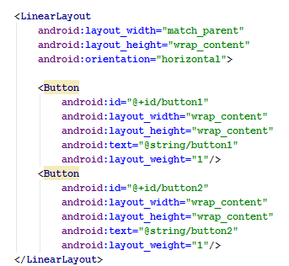
Button Example (activity_main.xml)

Slide 12
String Resources
A place to store all of the text to be used in the app
Located in the res folder
Referenced using “@string/[name]”

Slide 13
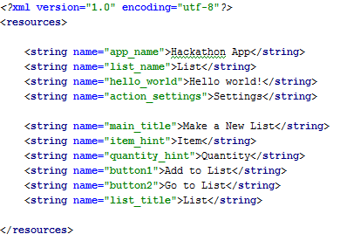
String Resources Example (strings.xml)

Slide 14
ListViews
Displays a list when rendered
List items displayed programmatically
Attributes:
id: ID of the View (stored as an int)
layout_width: width of the View
layout_height: height of the View

Slide 15
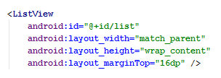
ListView Example (activity_list.xml)

Slide 16
List Items
The display for a single item in the list
Contains many widgets to make up one item
TextViews
ImageView

Slide 17
TextViews
Displays text when rendered
You must assign its attributes to give it a desired look
layout_width: width of the View
layout_height: height of the View
id: ID of the View (stored as an int)
text: text to be displayed

Slide 18
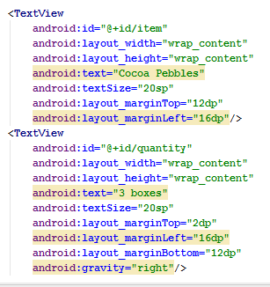
List Item/TextView Example (list_item.xml)

Slide 19
Activities
The basic building blocks of an Android app
Each screen is an activity
Each activity can have one or more fragments
Each activity and fragment is defined by an XML layout

Slide 20
Intents
Abstractly defines an operation to be executed
Can be used to start new activities, send broadcasts
Can be explicit or implicit
Explicit – explicitly defines what action is to be performed
Implicit – vaguely defines an action, and anything that can do it offers to do it

Slide 21


Intent Example (MainActivity.java)

Slide 22
Activity Life Cycle
Between being created and killed, each activity goes through life cycle phases
onCreate() – Called when the activity is first created
onStart() – Called when the activity is restarted
onResume() – Called when activity is resumed
onPause() – Called when activity is put in background
onStop() – Called when activity is no longer visible
onDestroy() – Called when activity is killed

Slide 23
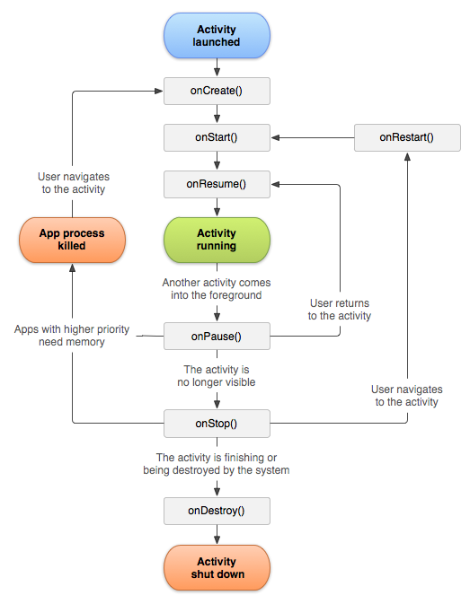
Activity Life Cycle Diagram

Slide 24
onClickListeners
Makes the item that it’s set on clickable
Instantiated as an inner class within an activity method
onClick() method is to be overridden with what to do when the thing is clicked

Slide 25
Toasts
Used to respond to user
Displays a small piece of text
Created an displayed programmatically

Slide 26
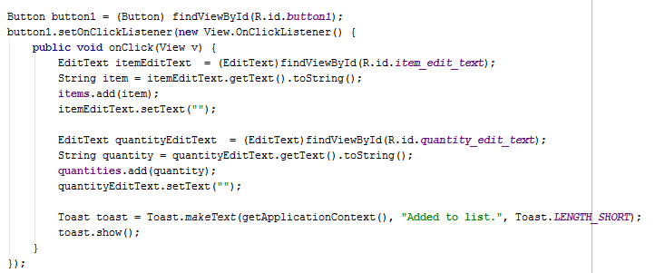
onClickListener/Toasts Example (MainActivity.java)

Slide 27
Intents Pt. II
Intents can also be used to communicate between activities
You can use a Bundle object to pass primitive and some object variables with the Intent to the opened activity
Use the startActivity() method to “start” the Intent, and with it, a new Activity

Slide 28
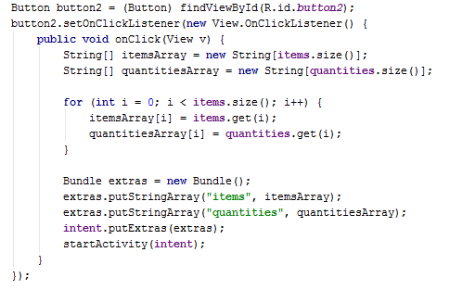
Intents Pt. II Example (MainActivity.java)

Slide 29
Android Manifest
An XML file that is necessary to have in your app package
Many items will be declared in it, so the runtime can understand what the heck is going on
ContentProviders
Permissions
Activities

Slide 30

AndroidManifest.xml

Slide 31
Custom Adapters
Used to take Arrays/ArrayLists and translate that into a list item
Override getView() to return the type of View that you want to use, and what to do with that View
What text to display
What image to render

Slide 32
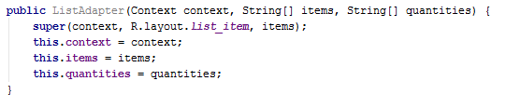
Custom Adapter Example (ListAdapter.java)

Slide 33
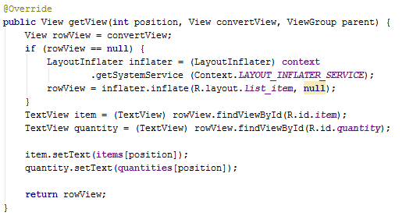
Custom Adapter Example (cont.) (ListAdapter.java)

Slide 34
Setting Adapters
To actually make the app show the list items, you must set the adapter to the desired list
Use the custom adapter’s constructor to associate the necessary text with the adapter
Then, set that adapter to the ListView that you want the list items displayed in

Slide 35
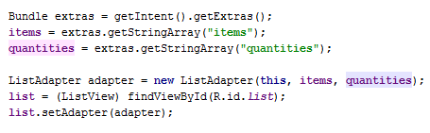
Setting Adapters Example (ListActivity.java)

Slide 36
Congrats!
You’re done with your first Android app
There’s a LOT left to learn
Luckily, there are also a LOT of resources
Android developer site: http://developer.android.com/training/index.html
Vogella: http://www.vogella.com/tutorials/android.html
StackOverflow: http://stackoverflow.com

